Slide 1

Highlands School District
Standards-Aligned Reporting of Student Progress

Slide 2
Highlands School District
Assessment/Grading Philosophy Statement
The purpose of a report card is to describe students’ learning progress to their parents and others, based on our district learning expectations. It is intended to share information about successes and to provide guidance in areas where improvement is needed.
Our current reporting system is not effective at providing clear and consistent learning data. Grades are incongruent with other indicators of achievement. The shift in our instruction toward the PA Core Standards creates an opportunity to improve this process.

Slide 3
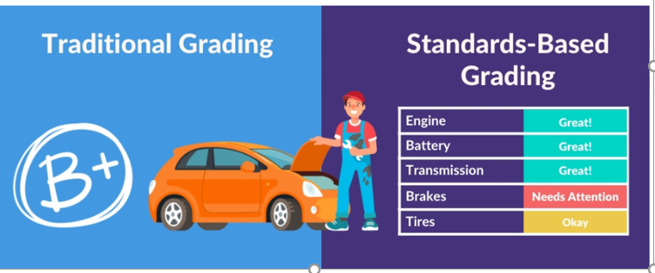
Which is more helpful?

Slide 4

What are the key differences between traditional and standards-based reporting?

Slide 5

#1 – On standards-based report cards the specific learning target(s) is listed rather than the subject area.
Traditional report card:
  Math
  Reading
  Science
  Social Studies
.
Standards based reporting:
Reads and records time to the half-hour.
Adds and subtracts 3-digit numbers.
Identifies the character and setting in a story.
Reads with correct phrasing, and expression at a rate of at least 71 words per minute.

Slide 6
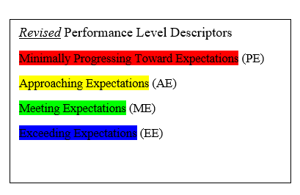
# 2: Traditionally, progress is reported with letters or percentages. On a standards- based report card, progress is reported on level of mastery toward benchmarks.
Traditional report card:
A or 96%
B or 85%
Standards- based reporting options:
1,2,3,4
Advanced, Proficient, Basic, Below Basic
Beginning, Developing, Secure
Exceeds, Meets, Approaches Expectations
Highlands Performance Level Descriptors

Slide 7
#3 Averaging is not used to find a total score or percentage. Past performance is not held against students if they exhibit evidence of mastery by the end of the learning period.
Traditional Report Card
Standards Aligned Reporting
Identifies Characters and Setting:
Weekly Test 1: 2/5
Teacher made checkup: 2/4
Weekly Test 2: 3/4
Weekly Test 3: 1/3
Teacher made checkup: 2/3
Theme Three: 7/8
Reading Performance Task: 3/4
AVERAGE: 61%
Identifies Characters and Setting
Weekly Test 1: AE
Teacher made checkup: AE
Weekly Test 2: PE
Weekly Test 3: AE
Teacher made checkup: ME
Theme Three: ME
Reading Performance Task: ME
Overall: ME

Slide 8
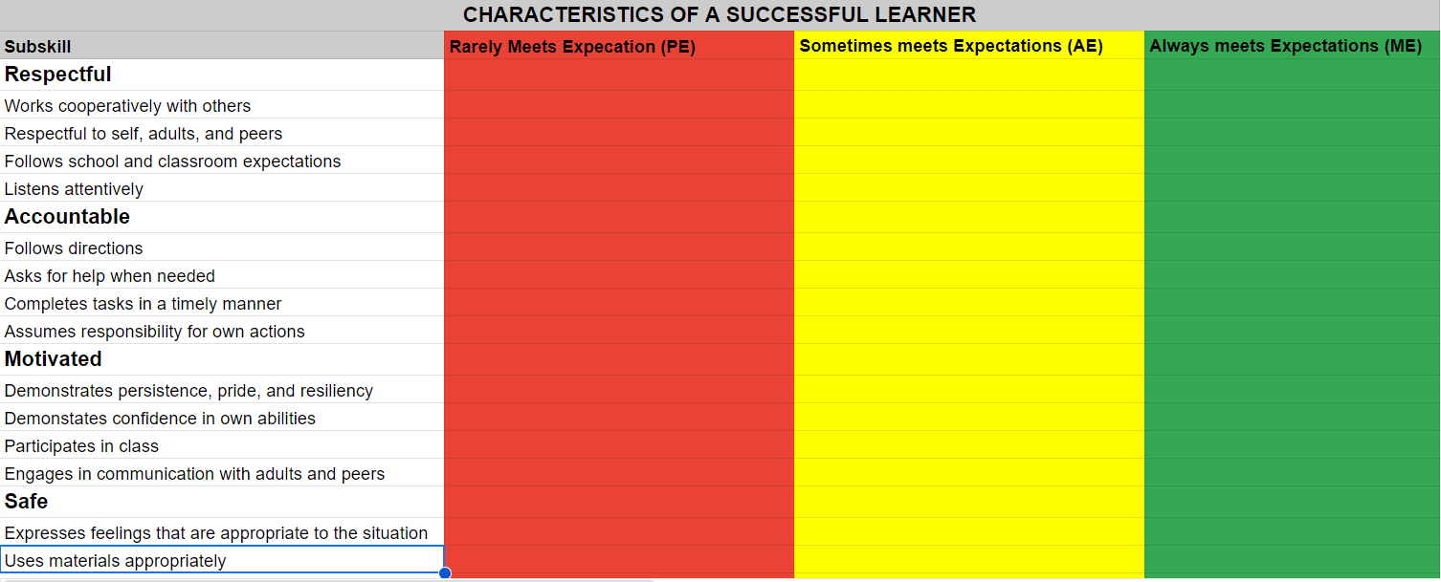
#4 – Traditional report card - points for effort, attitude, attendance, work habits, behavior, and homework are often factored into the grade. In standards-based reporting, these are reported separately.

Slide 9
What does Mastery Look Like?
Performance descriptors that align with our district vision
PE Minimally Progressing Grade Level Expectations Student is not yet demonstrating an understanding of the knowledge and skills expected at grade level and requires individualized instruction and teacher support. | AE Approaching Grade-Level Expectations Student is making some progress toward the mastery of the knowledge and skills expected at this grade level but still requires additional guidance and support. | ME Meeting Grade-Level Expectations Student consistently demonstrates mastery of the knowledge and skills expected at this grade level and can do so with independence. | EE Exceeding Grade-Level Expectations Student consistently demonstrates an understanding above and beyond what is expected at this grade level and benefits from differentiated instruction. | Blank

Slide 10

What will this look like?
At the end of every unit in Math and ELA, there will be a common assessment given to students. We will use the results of the common assessment to confirm students’ level of understanding and evaluate students’ progress toward grade level-standards.
Parents will receive both the traditional report card and a standards aligned report for the standards taught during that marking period.

Slide 11
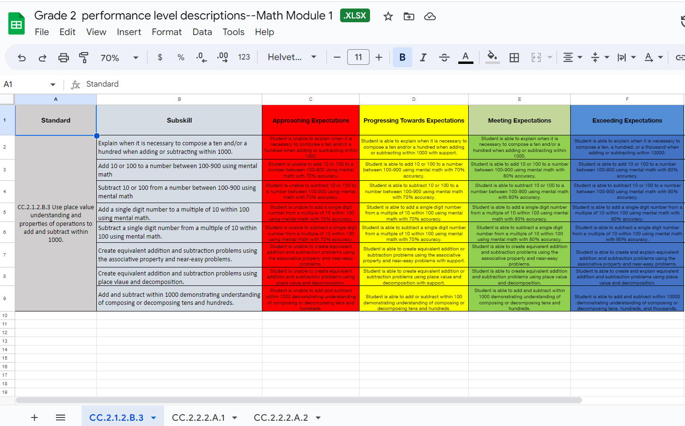
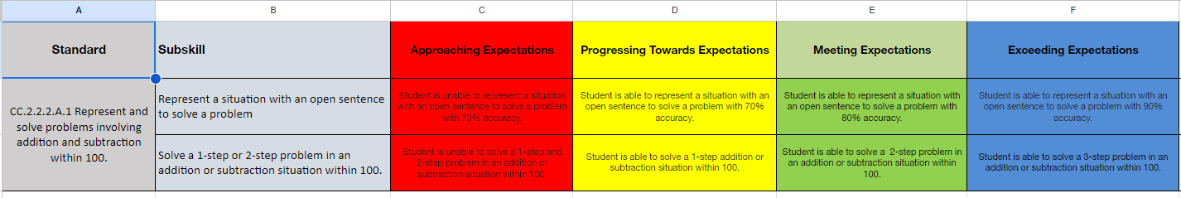
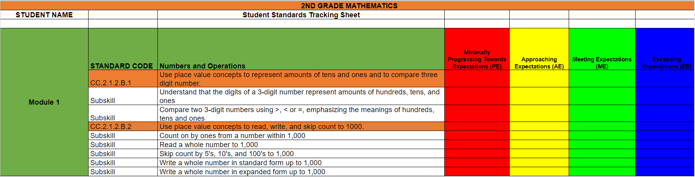
Performance Level Rubrics and Student Tracking Sheets
Describe what student performance looks like at each of the performance levels for each subskill.
Will be used to determine the final evaluation of students’ understanding of the standards.

Slide 12

QUESTIONS or COMMENTS?

